Slide 1
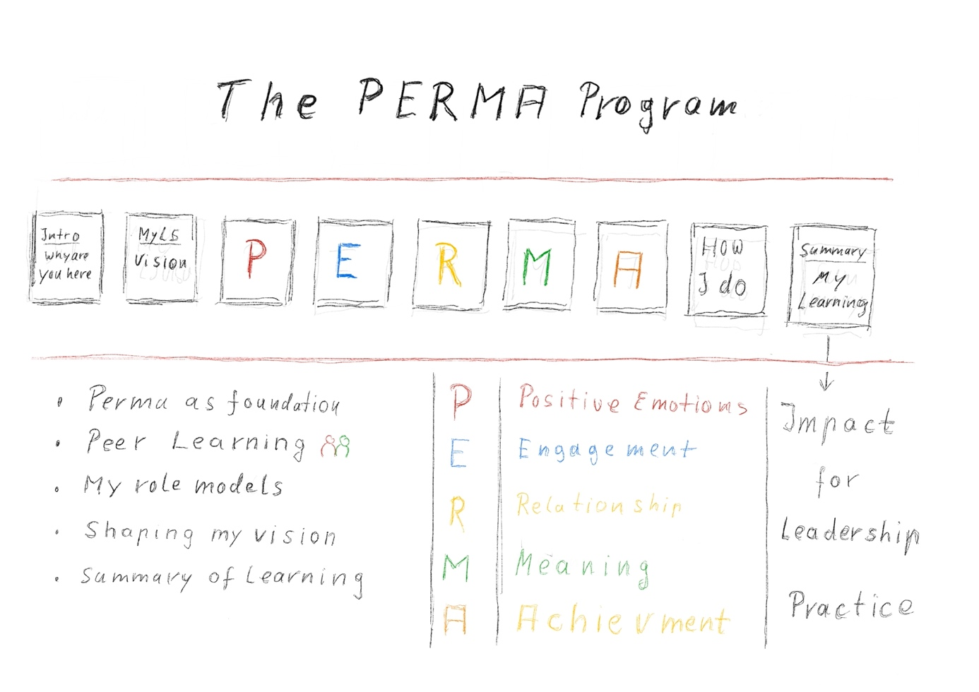
African Wo-Men Leadership –
The PERMA Program powered by SADA
A digital, web app-based learning path
For the development of positive psychological and behavioural skills as a basis for fair, inclusive and sustainable digital societies in Africa

Slide 2
African Wo-Men Leadership –
PERMA Program - Goals
Goals
Strengthening African women and men in their inclusive and cooperative leading behaviour
Improvement of Positive Psychological literacy and skills for effective leadership and decision making in business and politics
Promoting digital skills, e.g. leading through digital learning solutions
Large scalability of programs across Africa and the diasporas
Modularity and tailoring of learning contents

Slide 3
African Wo-Men Leadership –
PERMA Program - Target Group
African women & men
Between 20 - 45 years
Decision-makers in business and politics
Founders, entrepreneurs, public and private institutions from various sectors of activities
Innovators and change-makers in Health, agriculture, banks, finances, media & communication, industrial, etc.

Slide 4
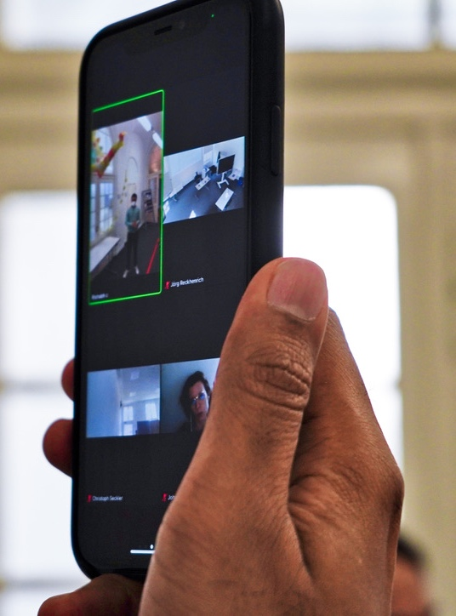
African Wo-Men Leadership –
PERMA Program - Key Elements
Introducing to core principles of Positive Psychology
Skills for implementation in daily leadership practice
State of the art digital learning solution
Availability on all devices
Guidance and support from experienced learning coaches
Networking and Peer Exchange between participants & external leaders and high-level resources persons
A simple step by step program dynamic
Latest scientific research on leadership & cultural diversity
Based on the experience of the pre – pilot

Slide 5
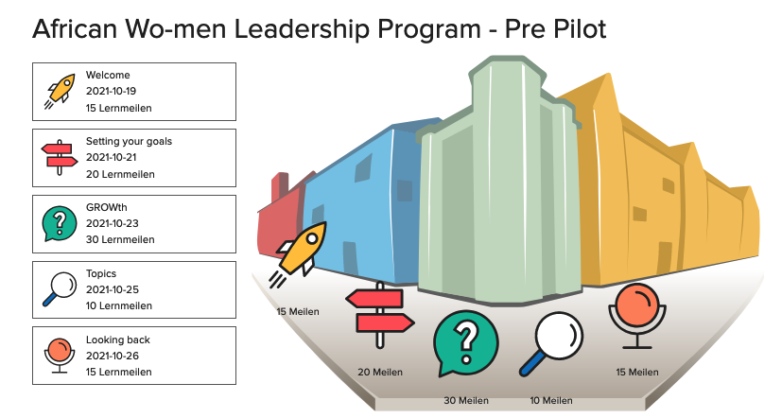
African Wo-Men Leadership –
PERMA Program – Test
Learning path, Co-creation of “Girls for Tech and Innovation Africa” and PPARTs - first internal testing situation
Pre-Pilot Test (Oct. 2021) - 10 Day Path
Defining personal development goals
Experiencing positive emotions
Creating and leading trustworthy effective conversations
Collection of ideas for further topics and feedback
Pitch to Global Leadership Academy Community- Nov 2021 for feedbacks & new ideas.

Slide 6
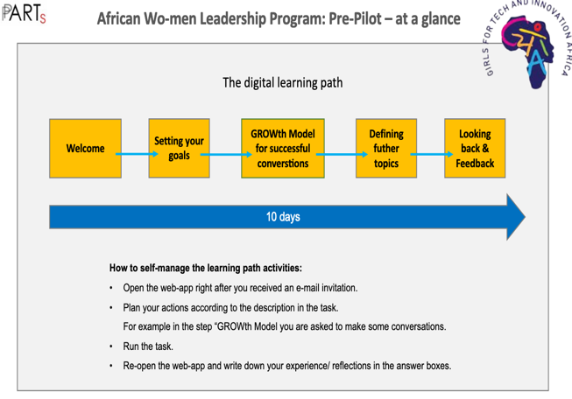
African Wo-Men Leadership –
PERMA Program – Pre-Pilot
The setting
13 participants (4 males/9 females) from:
Medical – 2
Business – 2
Banking & insurance – 2
Social worker and teaching – 2
Peacebuilding – 2
Media & marketing – 2
Independent consultant – 1 originated from central, eastern and west Africa including the diaspora
Notes:
Majority of participants spontenously followed the given rhytm with flexible time management
5 made a deep dive immediately from the Goalsetting session
Using Arts works and pictures captured their attention
Proposed topics include: Self-discovery and harnessing oneself talents; accountability and women empowerment; communication and building trust with teams for problem solving and decision making; women inclusion; building better and strong relationships

Slide 7
African Wo-Men Leadership –
PERMA Program – Pre-Pilot
Description of experiences:
Technically no hurdle, addressing individual challenges, defining and approaching personal development goals, interaction with relevant peers in the daily routine
Majority of participants spontaneously followed the given rhythm with flexible time management
5 made a deep dive immediately from the Goalsetting session
Using Arts works and pictures captured their attention
Proposed topics include: Self-discovery and harnessing oneself talents; accountability and women empowerment; communication and building trust with teams for problem solving and decision making; women inclusion; building better and strong relationships
Notes:
Majority of participants spontenously followed the given rhytm with flexible time management
5 made a deep dive immediately from the Goalsetting session
Using Arts works and pictures captured their attention
Proposed topics include: Self-discovery and harnessing oneself talents; accountability and women empowerment; communication and building trust with teams for problem solving and decision making; women inclusion; building better and strong relationships

Slide 8
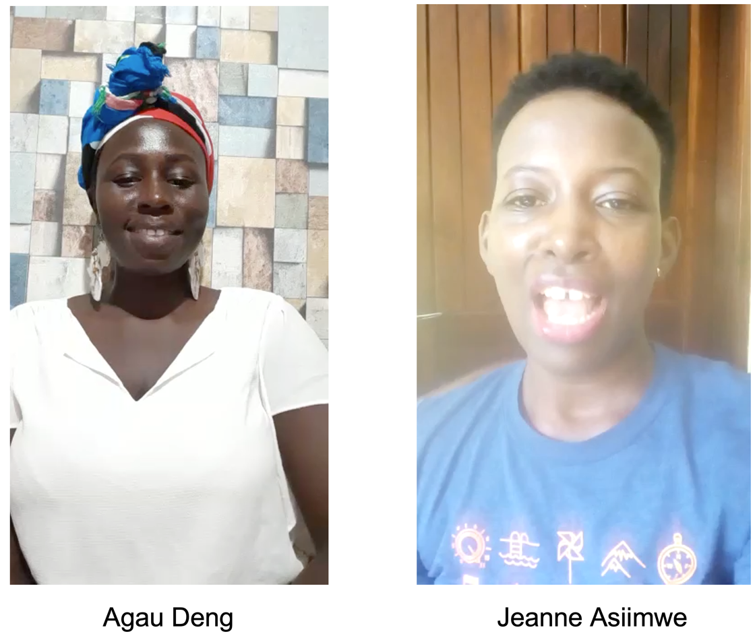
African Wo-Men Leadership –
PERMA Program – Pre-Pilot
How was your experience with the digital learning path? Testimonials:
The digital learning path caused me to think through the topics at hand.
Putting them on paper caused me to step back one bit and really think through and answer with honesty.
The prompt response from the Learning Coaches was greatly appreciated.
The learning path very connected to real life experinces of participants

Slide 9
African Wo-Men Leadership –
PERMA Program – Next Steps
Next Steps:
Alignment of the digital approach and program content with the SADA goals
Full thematic pilot program enrolment in cooperation with SADA
Participants: 100 fe-male leaders in business and politics Duration: 6 Week for each thematic session/journey
Planning of scalability across eastern, central and west Africa regions and the diaspora
Creating topic related peer-groups (ea. Entrepreneurs, Policy-makers and regulators) for networking, exchange and further learning

Slide 10
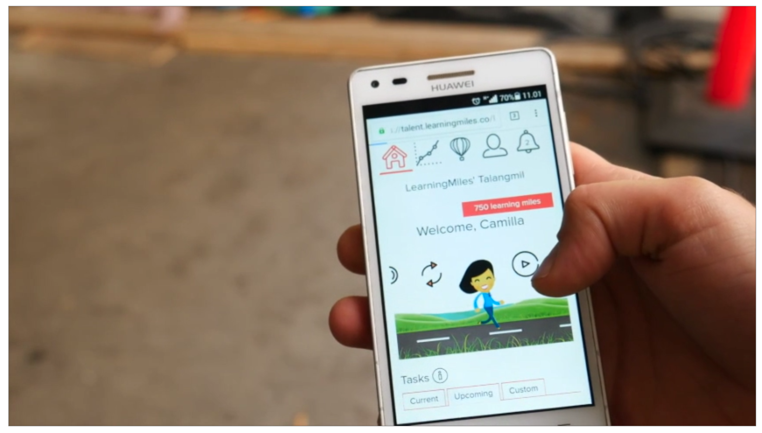
African Wo-Men Leadership –
The digital solution
Kontakt: info@pp-arts.de
Jörg Reckhenrich: +49170 9617181
https://pp-arts.net

